Slide 1

Robotic Process Automation using UiPath
Topic 2- StudioX Citizen Developer Journey and Working with StudioX
HITESH KUMAR SHARMA
Technical Instructor & Consultant

Slide 2
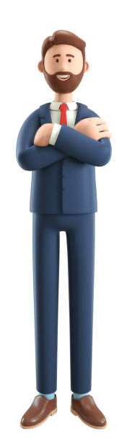
Introduction to RPA
StudioX Citizen Developer Journey and Working with StudioX
Activity Recording, UI Automation in StudioX
Decisions, Iterations, and Scenarios in StudioX
File, Folder Automation in StudioX: Microsoft Excel Automation
Email & SAP Automation in StudioX
Handle Errors in StudioX
COURSE OBJECTIVES

Slide 3
2. StudioX Citizen Developer Journey and Working
with StudioX
StudioX UI Exploration
Installing Excel, Outlook and Google Suite Plugin
First automation using Microsoft Office
Map the HumanPath, Design the RobotPath

Slide 4
StudioX UI Exploration
UI automation refers to the automation of desktop applications and web browsers. It can replicate clicking and typing in various user interface elements such as buttons, check boxes, text boxes, or drop-down lists. Knowing how to interact with them enables you to design automations much faster and easier. With StudioX, you can create automations with UI elements from most applications using application or web activities.
StudioX offers deep integration with Microsoft Office, Outlook 365, Gmail, and the file system.
All interactions with the UI can be split into
Input (sending or adding something to the application)
Output (getting something from the application). Clicking a button and typing text in a text box are examples of input actions. Getting the text from a browser page is an example of an output action.

Slide 5
StudioX UI Exploration Hands-On
5 Mins Demo for UI Exploration
Identification of Text Box and Button

Slide 6
StudioX UI Exploration (Contd..)

Slide 7
UI INTERACTION
INPUT METHOD
OUTPUT METHOD
Click
Text
Keyboard
Right click
Mouse hover
Get text
Get full text
Get visible text
Get OCR Text

Slide 8
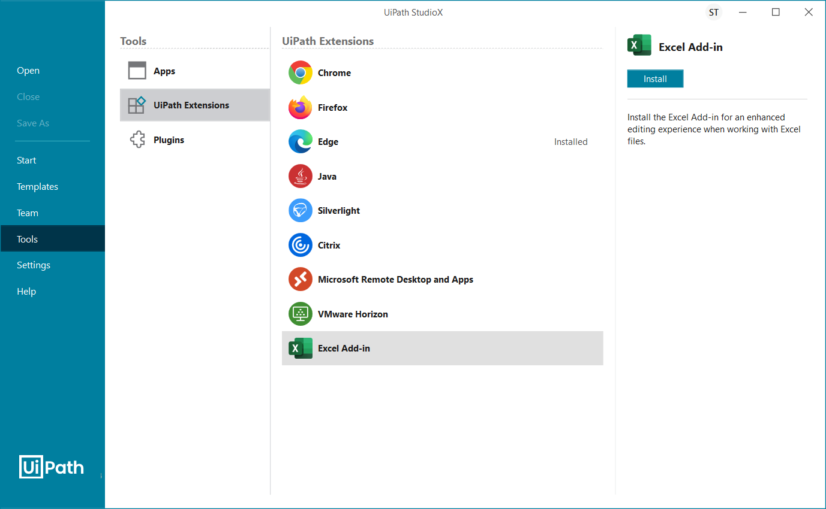
Installing Excel, Outlook and Google Suite Plugin
Install the Excel Add-in
Save and close all open Excel workbooks.
In Studio, select Home > Tools > UiPath Extensions > Excel Add-in.
Click OK to confirm you have saved and closed all Excel workbooks.
The add-in is installed and a confirmation message is displayed. Click OK to close the message.

Slide 9
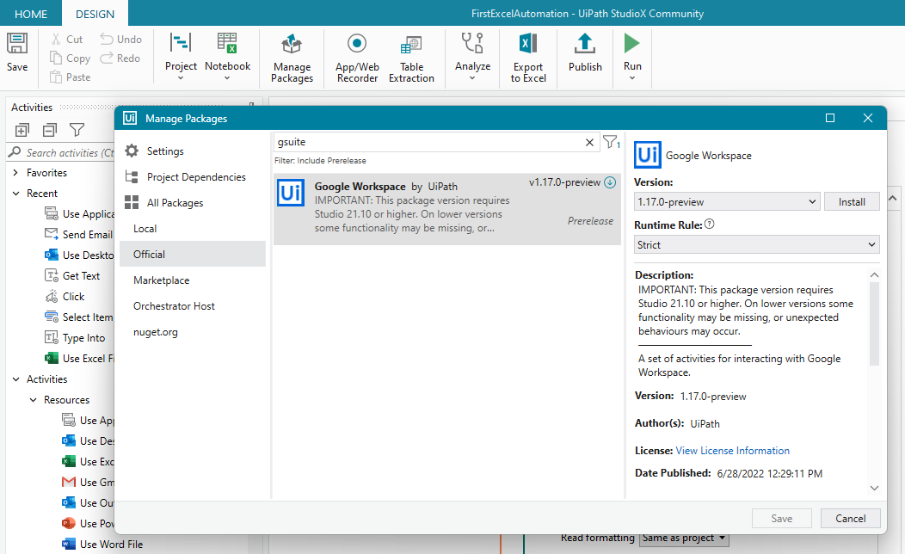
Installing Excel, Outlook and Google Suite Plugin
Install the Google Suite Add-in
In Studio,
select Manage Package > Official
Click Install to Install
Click Sav

Slide 10
First automation using Microsoft Office
(LIVE-DEMO)
Open a Web Form (https://www.rpasamples.com/findunicornname)
Create an Excel Sheet with Some Entries
Create an Automation in UiPath StudioX to read Excel Sheet for Input
Type Entries into web from using Automation
Click on Web Form using Automation
Get Text from Webform using automation
Send a Mail contains the text retrieved from web form using Automation.

Slide 11
Map the HumanPath, Design the RobotPath
The HumanPath is a high-level view of your task put into a sequential manner. The RobotPath is a detailed view of your task - it's designing the steps the Robot takes to automate your task.
Here are some highlights of what makes the HumanPath to RobotPath framework important in your development process:
Breaks down your process into visual, logical steps.
Helps you carve out the scope of what you want to build.
Outlines key decision points and task automation scenarios.
Serves as your guide while you build your Robot.

Slide 12
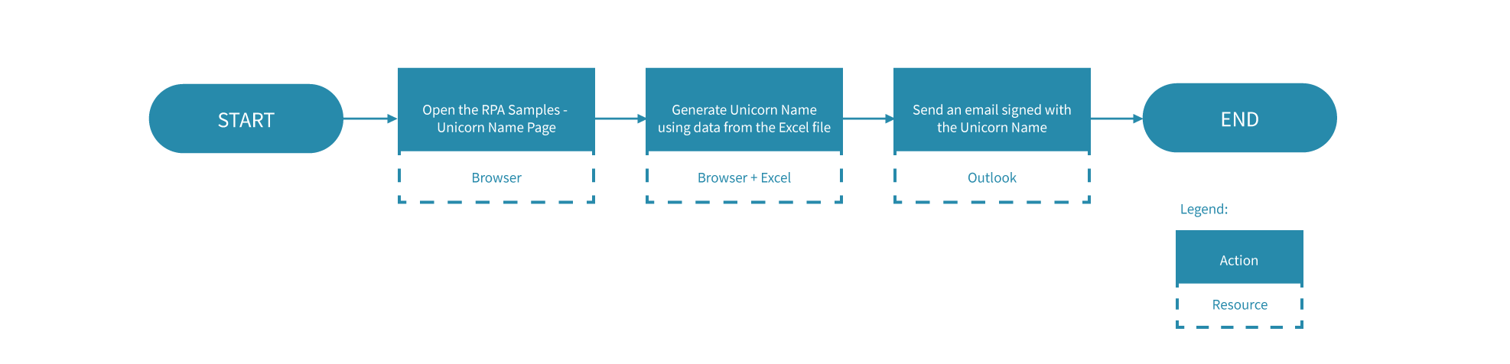
The HumanPath
The HumanPath is just a high-level overview of the task's steps.
Notice how there is a Start and an End, and only three steps in between. Each step is descriptive enough for an outsider to understand the task and the applications used:
You open the RPA Samples Unicorn Name website using the browser of choice.
Using the information from the Excel file, you generate the Unicorn Name.
You send out an email, signing it with the Unicorn Name,

Slide 13
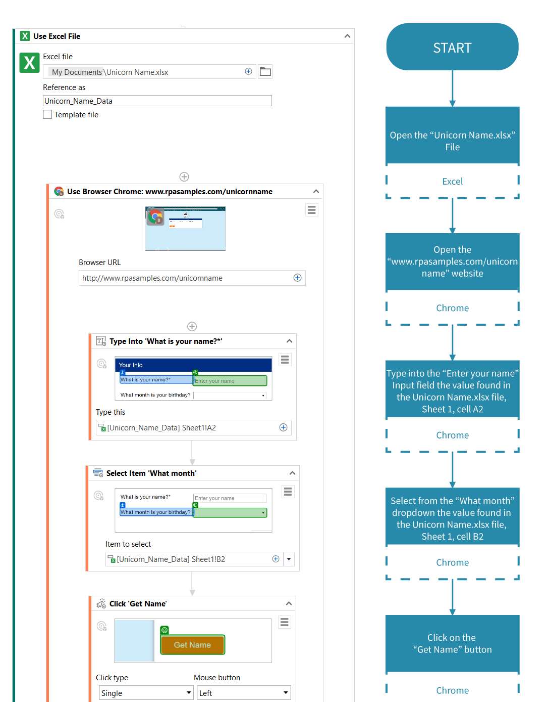
The RobotPath
The Robot Path is a more detailed overview of your task's steps. The objective is to have a click by click process flow. Imagine you give the Robot Path to a new hire instead of training. Let's take a look at the Robot Path of the Unicorn Name task automation.

Slide 14
TOPIC 2
END
THANK YOU

